Slide 1

RL Novels
Temporal-Difference Learning
© Amadeus IT Group and its affiliates and subsidiaries
Giovanni GATTI PINHEIRO
October, 11th 2019
AIR-REV-DPI-MLS
Notes:
Cover example with photo inside the shape
Insert new photo: Click on Insert photo-icon on slide and Insert new photo
Use Crop Tool under Picture Tools to pan and zoom
Beware: when you add or replace a picture, it may come to the front. Right click on it and select ‘Send to back’ to re-arrange it.
To update the text, just click on the text
To get more slides with this layout just copy this slide and paste
Please insert the other company’s logo in the same size as the Amadeus logo, with no background and reverse out colour

Slide 2
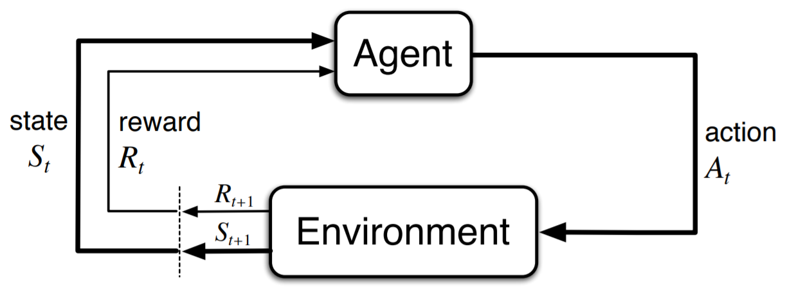
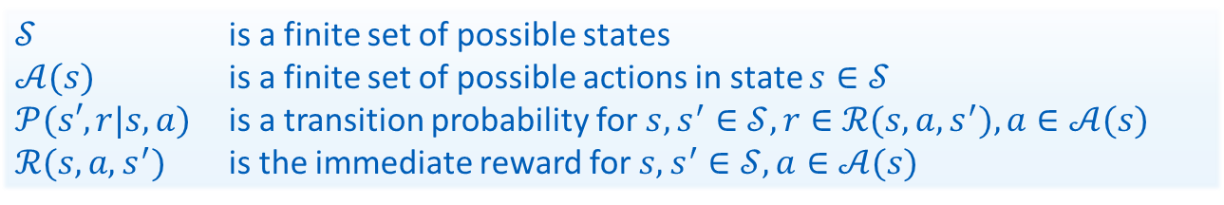
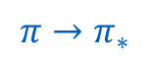
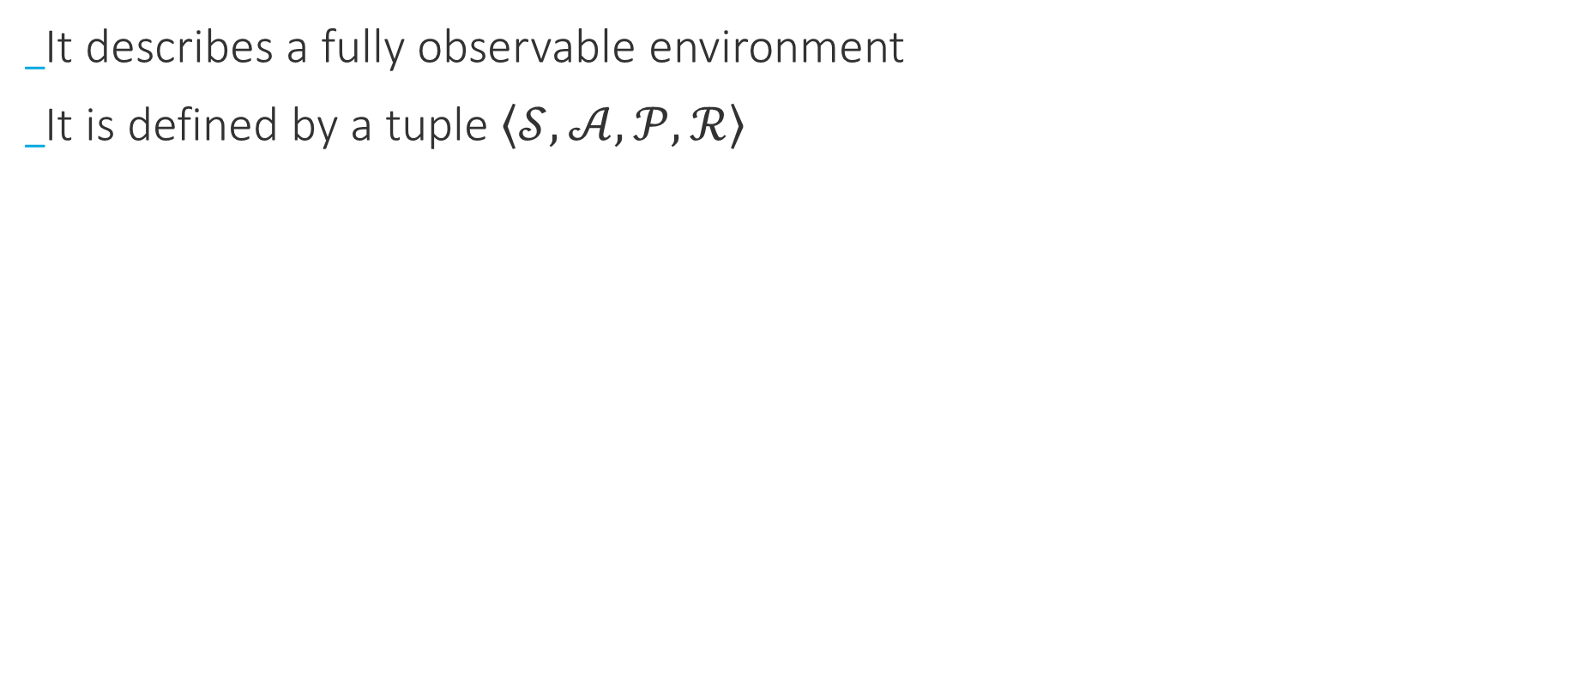
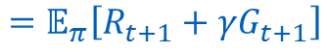
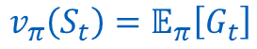
Review
Markov Decision Process
It describes a fully observable environment
It is defined by a tuple $\left\langle 𝒮, 𝒜, 𝒫,ℛ\right\rangle$
$$π→π_{∗}$$
Goal:
$$v_{π}\left(S_{t}\right)=𝔼_{π}\left[G_{t}\right]$$
$$=𝔼_{π}\left[R_{t+1}+γG_{t+1}\right]$$
$𝒮$ is a finite set of possible states
$𝒜(s)$ is a finite set of possible actions in state $s∈𝒮$
$𝒫(s′,r|s, a)$ is a transition probability for$s, s^{′}∈𝒮, r∈ℛ(s, a, s^{′}), a∈𝒜(s)$
$ℛ(s, a, s^{′})$ is the immediate reward for$s, s^{′}∈𝒮, a∈𝒜(s)$

Slide 3
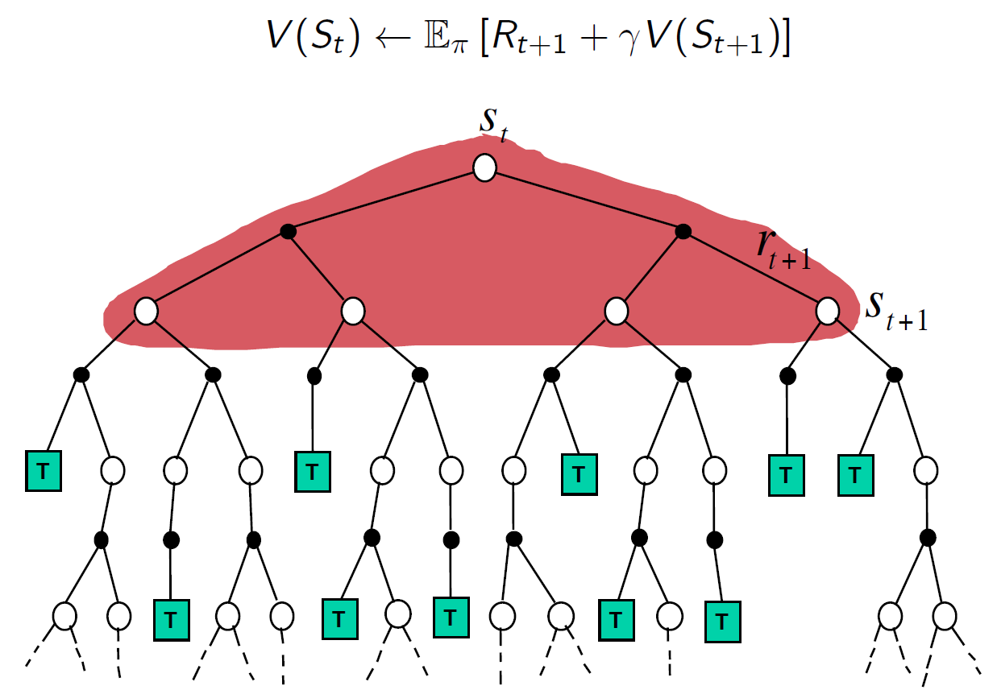
Review
Dynamic Programming
Infeasible for large state-spaces (curse of dimensionality)
model-based approach

Slide 4
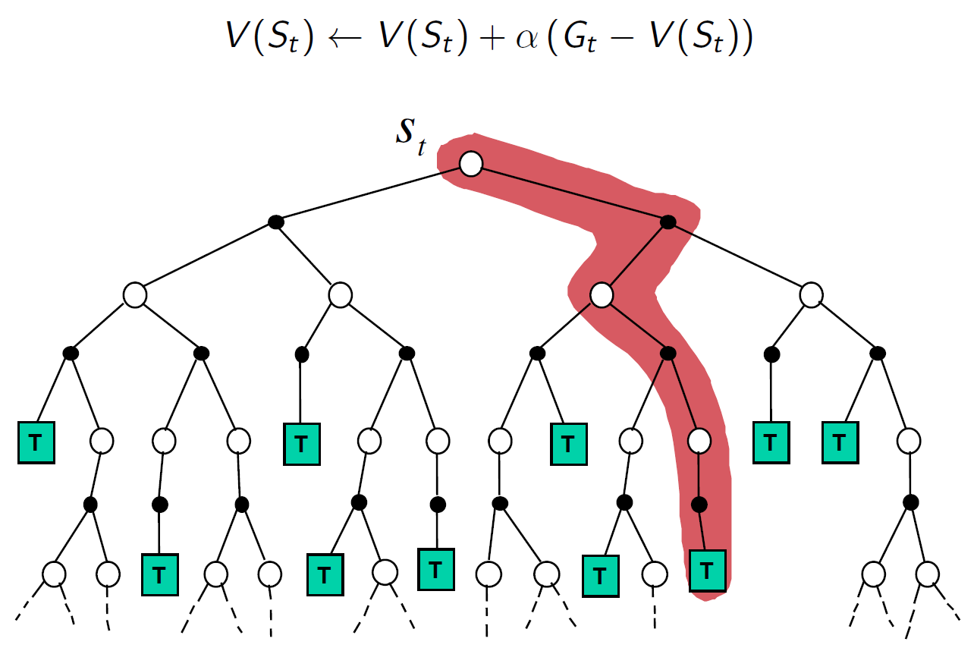
Review
Monte-Carlo methods
model-free approach
(side bonus) agent can focus on states that he is actually experiencing

Slide 5
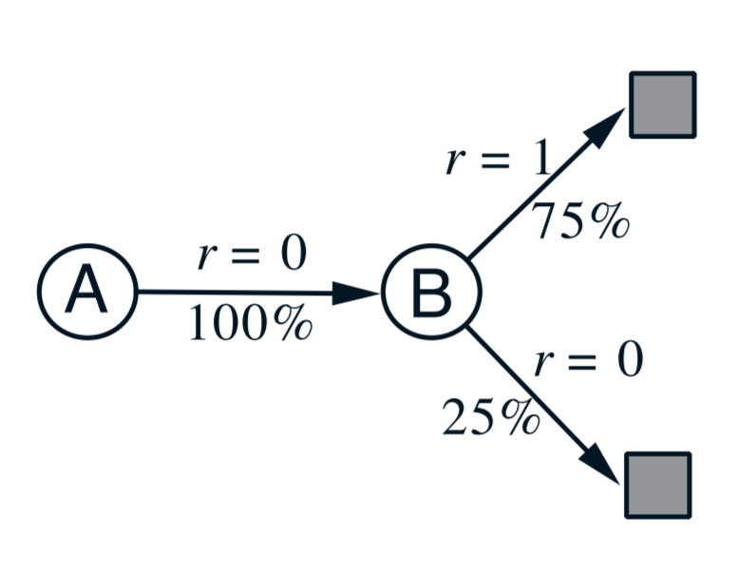
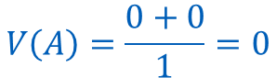
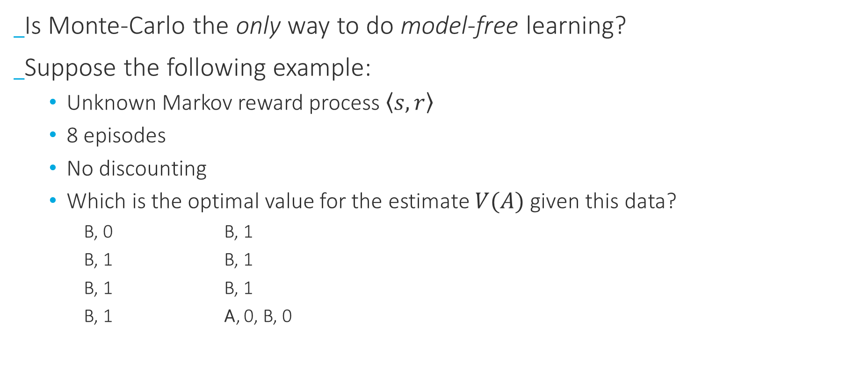
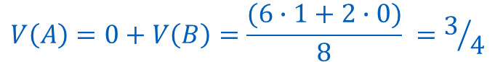
TD-Prediction
Intuition
Is Monte-Carlo the only way to do model-free learning?
Suppose the following example:
Unknown Markov reward process $\left\langle s, r\right\rangle$
8 episodes
No discounting
Which is the optimal value for the estimate $V(A)$ given this data?
B, 0 B, 1
B, 1 B, 1
B, 1 B, 1
B, 1 A, 0, B, 0
Answer 1:
Monte-Carlo
$$V\left(A\right)=\frac{0+0}{1}=0$$
TD-Learning
Answer 2:
$$V\left(A\right)=0+V\left(B\right)=\frac{(6∙1+2∙0)}{8} =3/4$$

Slide 6
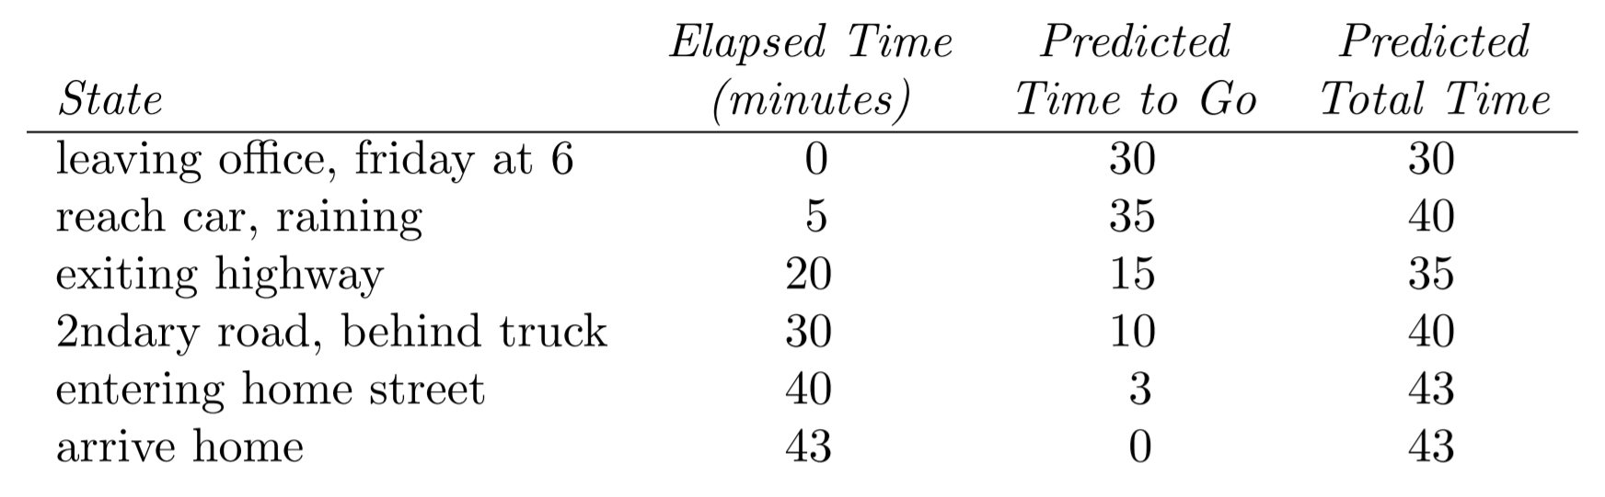
TD-Prediction
Intuition
Each day as we drive from home to work, we try to predict how long it will take to get there. We note anything that seams relevant (time, day, whether…)

Slide 7
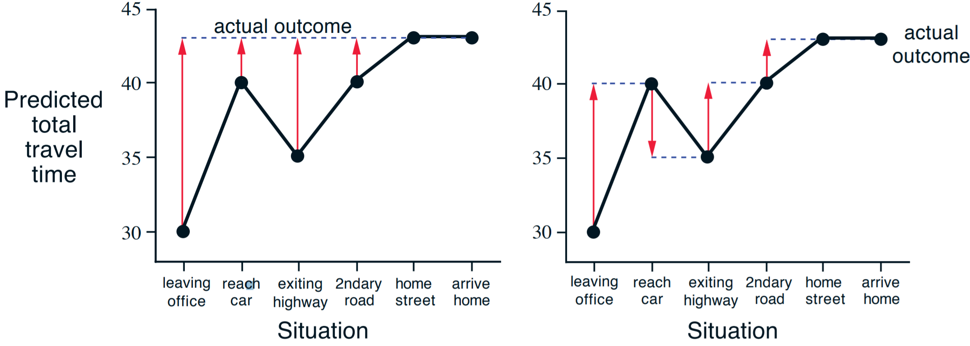
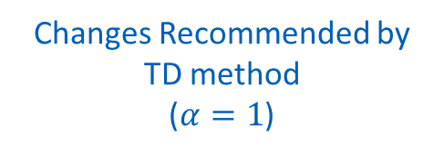
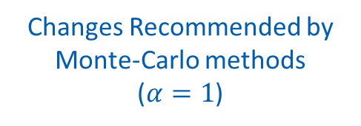
TD-Prediction
Suppose we moved to a new building and a new parking lot, but we still enter the highway in the same place: which method would perform better, Monte-Carlo or TD learning (at least initially)?
Intuition
Changes Recommended by TD method
($α=1$)
Changes Recommended by Monte-Carlo methods
($α=1$)

Slide 8
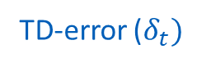
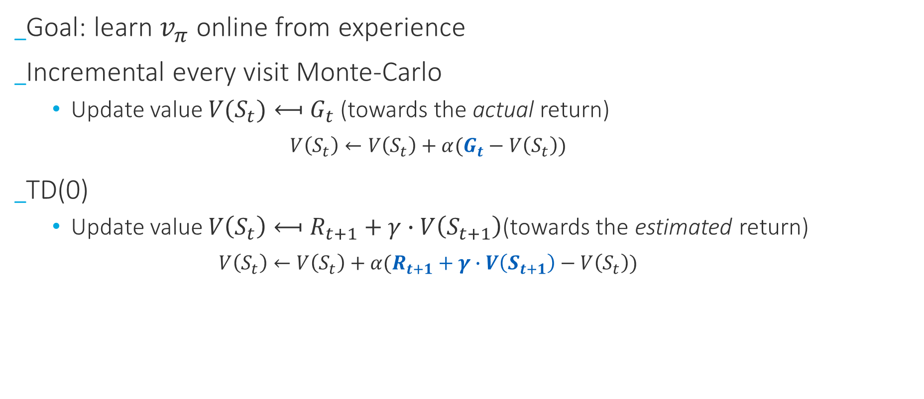
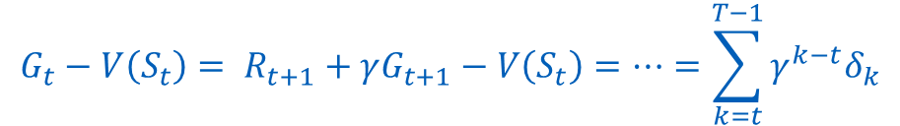
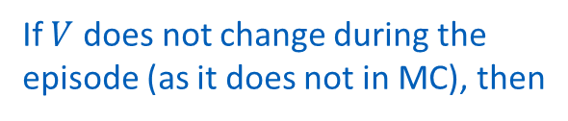
TD-Prediction
TD(0)
Goal: learn $v_{π}$ online from experience
Incremental every visit Monte-Carlo
Update value $V(S_{t})⟻G_{t}$ (towards the actual return)
$$V\left(S_{t}\right)←V\left(S_{t}\right)+α(G_{t}−V\left(S_{t}\right))$$
TD(0)
Update value $V\left(S_{t}\right)⟻R_{t+1}+γ∙V\left(S_{t+1}\right)$(towards the estimated return)
$$V\left(S_{t}\right)←V\left(S_{t}\right)+α(R_{t+1}+γ∙V\left(S_{t+1}\right)−V\left(S_{t}\right))$$
MC-error
There are similarities between them. Can’t we exploit it?
Subject of next RL novels talk!
TD-target
TD-error ($δ_{t})$
If $V$ does not change during the episode (as it does not in MC), then
$$G_{t}−V\left(S_{t}\right)= R_{t+1}+γG_{t+1}−V\left(S_{t}\right)=⋯=\sum_{k=t}^{T−1}{γ^{k−t}δ_{k}}$$

Slide 9
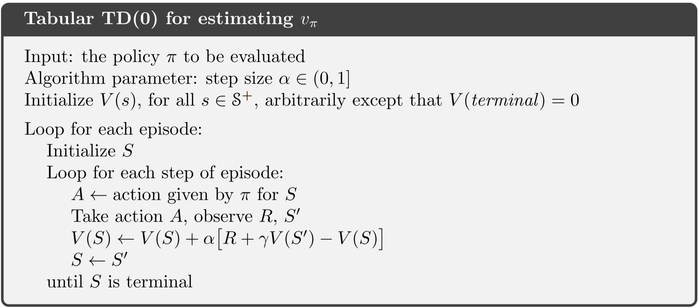

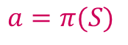
TD-Prediction
TD(0)
$$S$$
$$a=π(S)$$

Slide 10

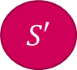
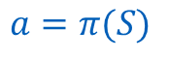
TD-Prediction
TD(0)
$$S$$
$$a=π(S)$$
$$R$$
$$S′$$

Slide 11
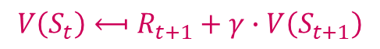

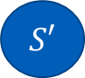
TD-Prediction
TD(0)
$$S$$
$$V\left(S_{t}\right)⟻R_{t+1}+γ∙V\left(S_{t+1}\right)$$
$$a=π(S)$$
$$R$$
$$S′$$

Slide 12
TD-Prediction
TD(0)
$$S$$
$$a=π(S)$$
$$R$$
$$S′$$

Slide 13

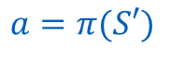
TD-Prediction
TD(0)
$$S$$
$$a=π(S)$$
$$R$$
$$S′$$
$$a=π(S′)$$
$$⋯$$
T

Slide 14
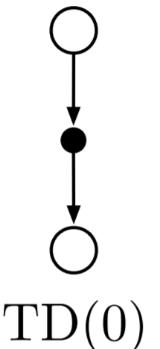
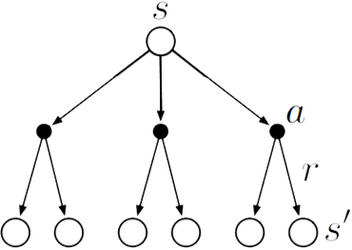
TD-Prediction
Advantages of TD-learning
TD methods learn estimates based in part on other estimates – they learn a guess from a guess (bootstrapping), like DP. Is it a good thing?
But, unlike DP they do not require a model of the environment (rewards and probability distributions)
Dynamic
Programming

Slide 15
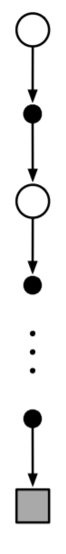
TD-Prediction
Advantages of TD-learning
TD methods can learn before knowing the final outcome, while MC needs to wait until the end of the episode
TD can learn without the final outcome, which makes it is suitable for continuous tasks
MC

Slide 16
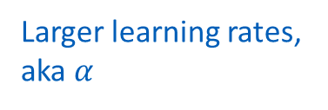
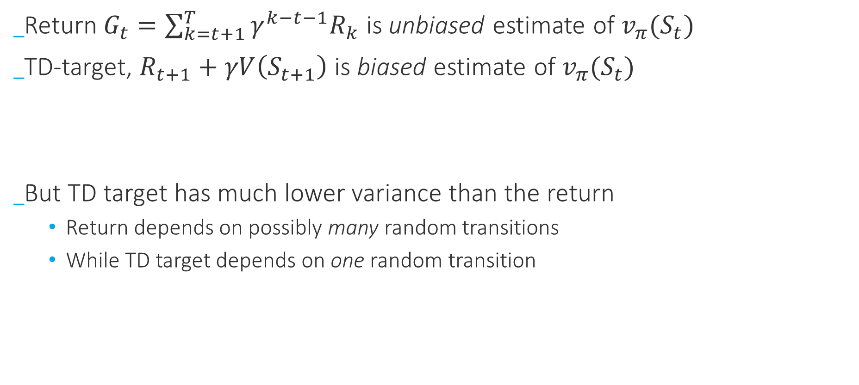
TD-Prediction
Not very sensitive to initialization
Advantages of TD-learning
Return $G_{t}=\sum_{k=t+1}^{T}{γ^{k−t−1}R_{k}}$ is unbiased estimate of $v_{π}(S_{t})$
TD-target, $R_{t+1}+γV\left(S_{t+1}\right)$ is biased estimate of $v_{π}(S_{t})$
But TD target has much lower variance than the return
Return depends on possibly many random transitions
While TD target depends on one random transition
Sensitive to initialization
Larger learning rates, aka $α$

Slide 17
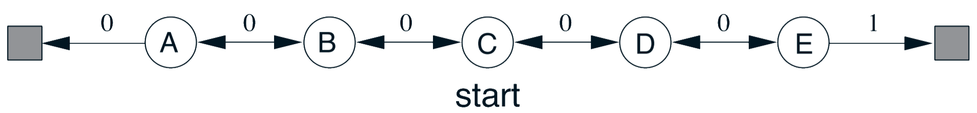
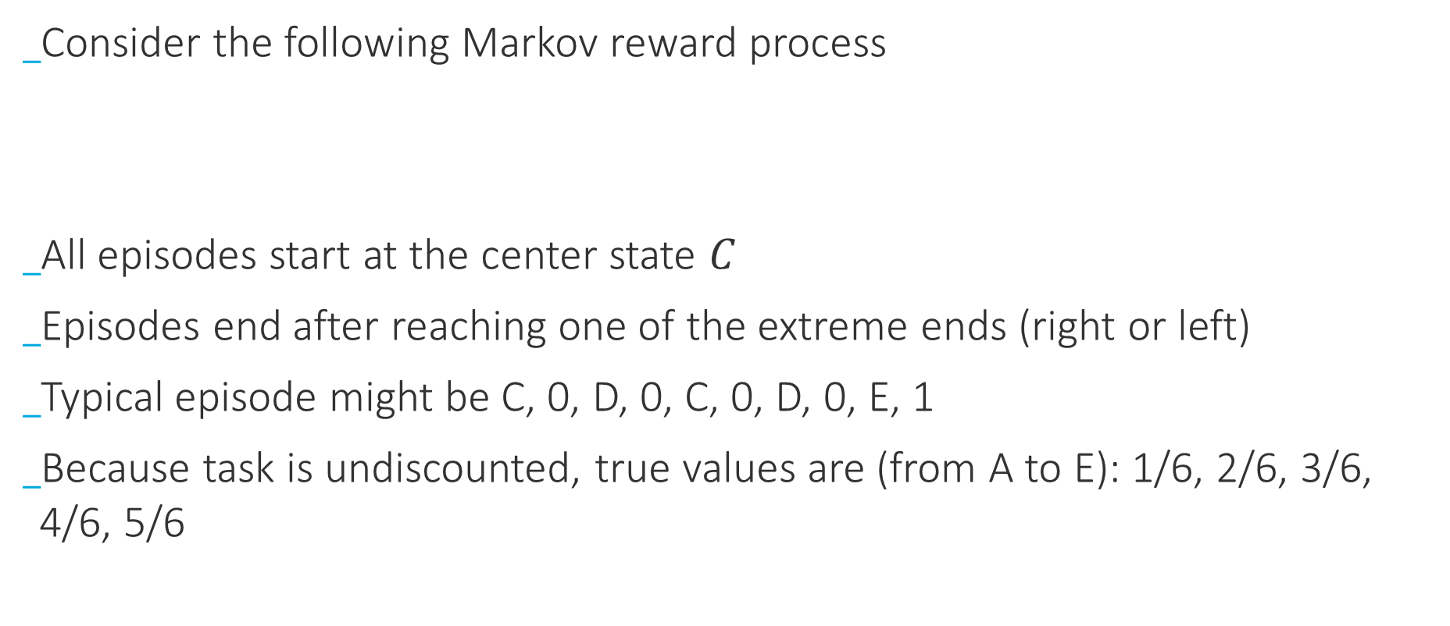
TD-Prediction
Advantages of TD-Learning
Consider the following Markov reward process
All episodes start at the center state $C$
Episodes end after reaching one of the extreme ends (right or left)
Typical episode might be C, 0, D, 0, C, 0, D, 0, E, 1
Because task is undiscounted, true values are (from A to E): 1/6, 2/6, 3/6, 4/6, 5/6

Slide 18
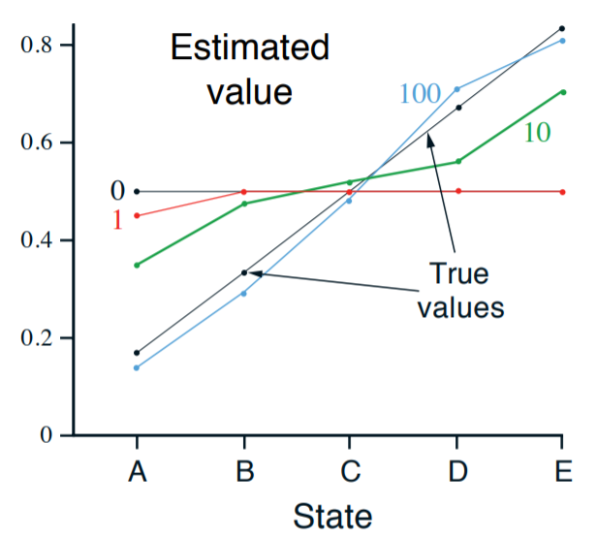
TD-Prediction
Advantages of TD-Learning
Can one tell what happened in the first episode?

Slide 19
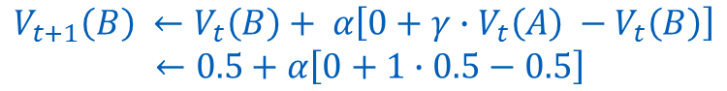
TD-Prediction
Advantages of TD-Learning
Why was it the only value changed?
$$V_{t+1}\left(B\right) ←V_{t}\left(B\right)+ α\left[0+γ∙V_{t}\left(A\right) −V_{t}\left(B\right)\right]$$
$←0.5+α\left[0+1∙0.5−0.5\right]$

Slide 20
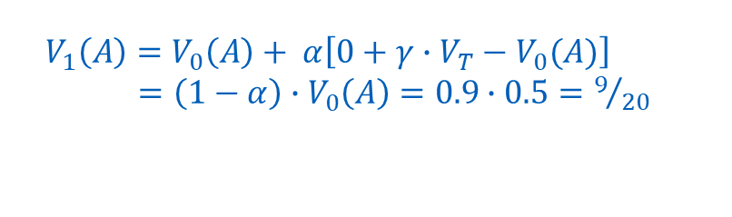
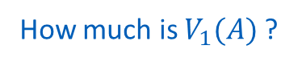
TD-Prediction
Advantages of TD-Learning
How much is $V_{1}(A)$ ?
$$V_{1}\left(A\right)=V_{0}\left(A\right)+ α\left[0+γ∙V_{T}−V_{0}(A)\right]$$ $=\left(1−α\right)∙V_{0}\left(A\right)=0.9∙0.5=9/{20}$

Slide 21
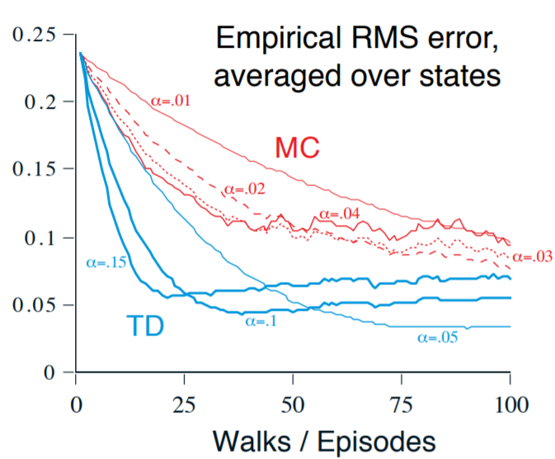
TD-Prediction
Advantages of TD-Learning
Note the variance
Issue…

Slide 22
TD-Prediction
Advantages of TD-Learning
Curiously moving up ?! Why?

Slide 23
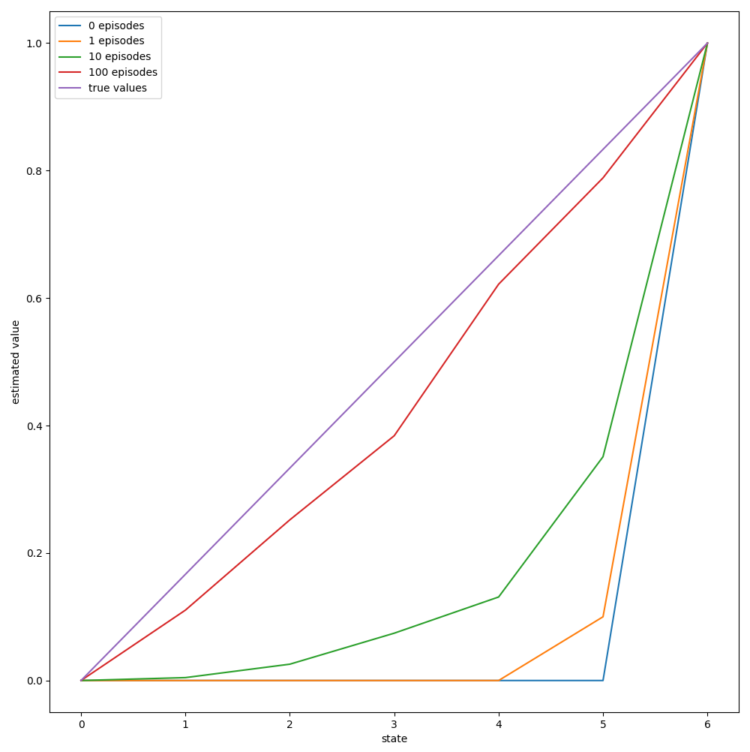
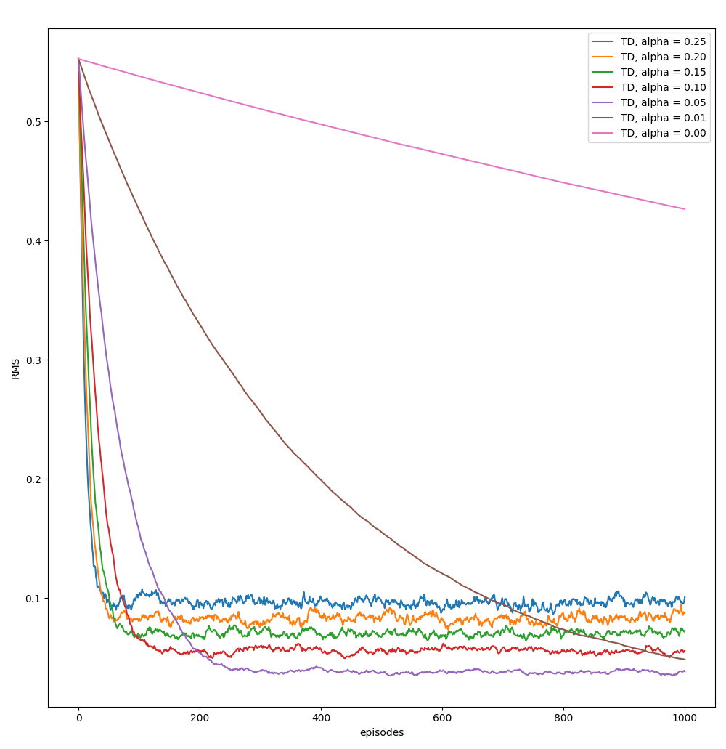
TD-Prediction
Advantages of TD-Learning
Bias issue?!

Slide 24
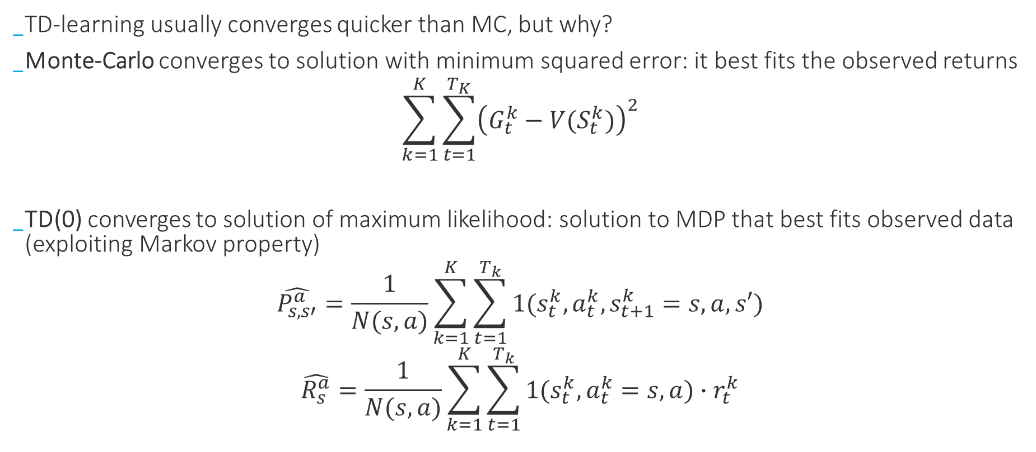
TD-Prediction
Advantages of TD-Learning
TD-learning usually converges quicker than MC, but why?
Monte-Carlo converges to solution with minimum squared error: it best fits the observed returns
$$\sum_{k=1}^{K}{\sum_{t=1}^{T_{K}}{{\left(G_{t}^{k}−V(S_{t}^{k})\right)}^{2}}}$$
TD(0) converges to solution of maximum likelihood: solution to MDP that best fits observed data (exploiting Markov property)
$$\hat{P_{s, s′}^{a}}=\frac{1}{N(s,a)}\sum_{k=1}^{K}{\sum_{t=1}^{T_{k}}{1(s_{t}^{k},a_{t}^{k},s_{t+1}^{k}=s,a,s′)}}$$
$$\hat{R_{s}^{a}}=\frac{1}{N(s,a)}\sum_{k=1}^{K}{\sum_{t=1}^{T_{k}}{1(s_{t}^{k},a_{t}^{k}=s,a)∙r_{t}^{k}}}$$

Slide 25
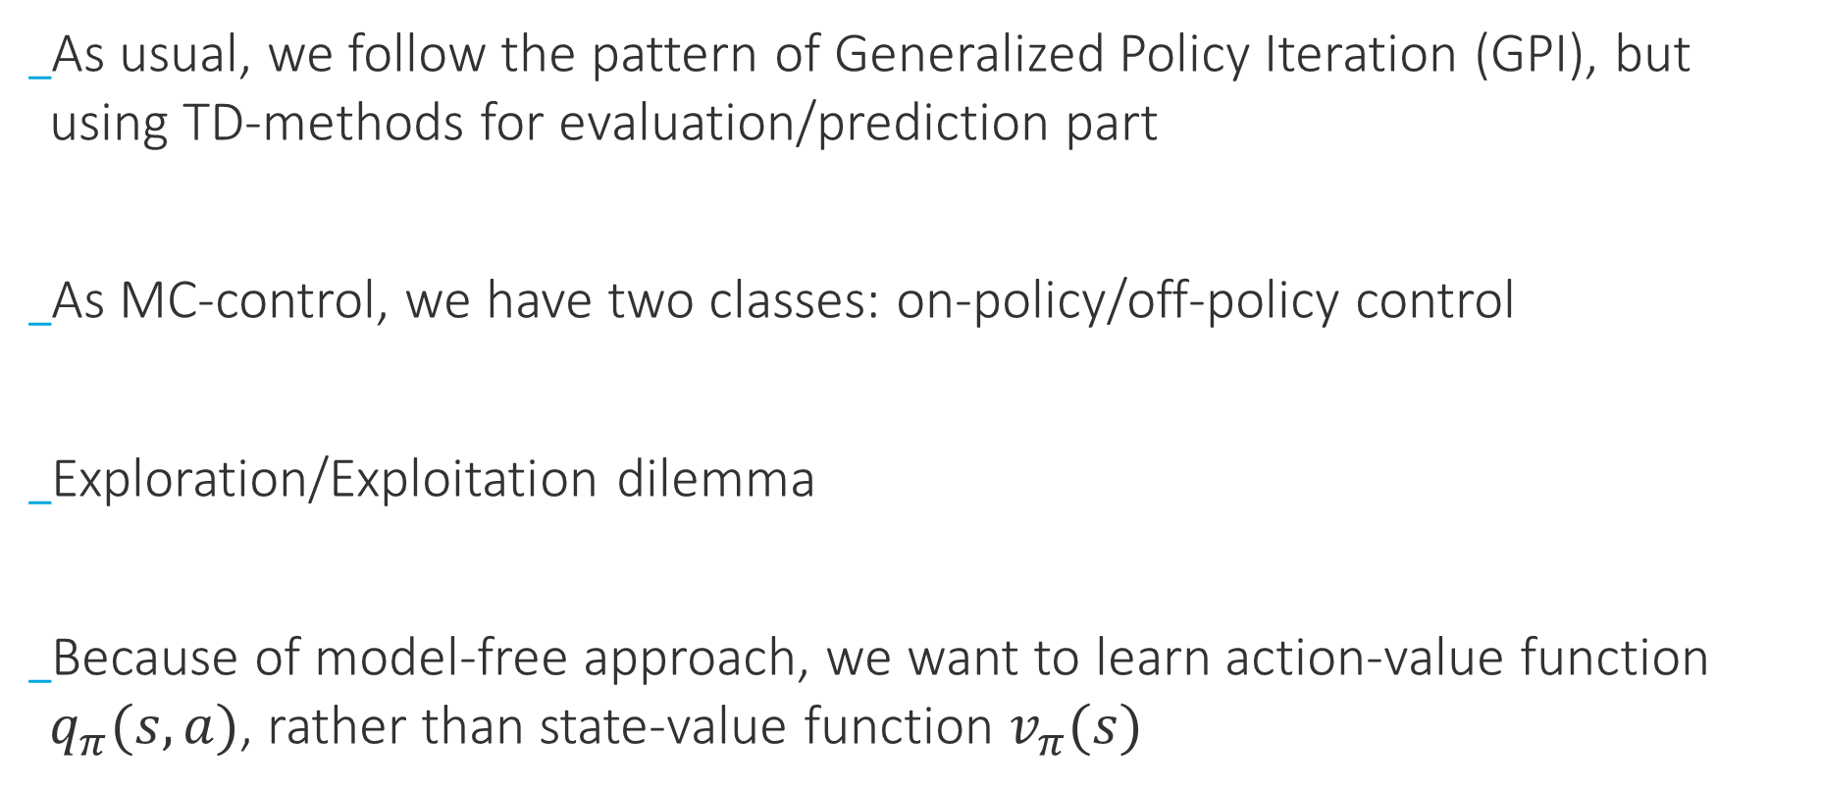
TD-Control
Requirements
As usual, we follow the pattern of Generalized Policy Iteration (GPI), but using TD-methods for evaluation/prediction part
As MC-control, we have two classes: on-policy/off-policy control
Exploration/Exploitation dilemma
Because of model-free approach, we want to learn action-value function $q_{π}(s,a)$, rather than state-value function $v_{π}(s)$

Slide 26
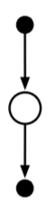
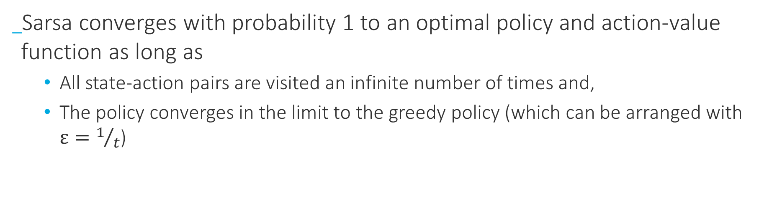
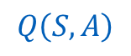
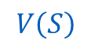
TD-Control
SARSA (On-Policy)
S, A
$$V\left(S_{t}\right)←V\left(S_{t}\right)+α\left(R_{t+1}+γ∙V\left(S_{t+1}\right)−V\left(S_{t}\right)\right)$$
TD(0)
R
$$V\left(S\right)$$
S’
$$Q\left(S,A\right)$$
$$Q\left(S_{t},A_{t}\right)←Q\left(S_{t},A_{t}\right)+α(R_{t+1}+γ∙Q\left(S_{t+1},A_{t+1}\right)−Q\left(S_{t},A_{t}\right))$$
SARSA
A’
Sarsa converges with probability 1 to an optimal policy and action-value function as long as
All state-action pairs are visited an infinite number of times and,
The policy converges in the limit to the greedy policy (which can be arranged with $ε=1/t$)

Slide 27
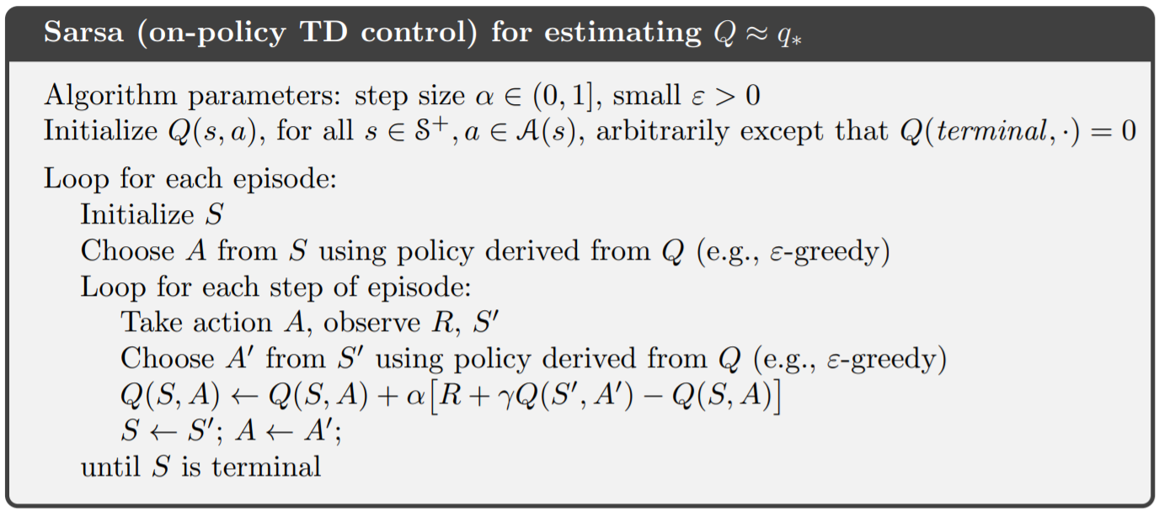
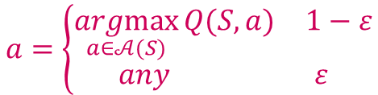
TD-Prediction
SARSA (On-Policy)
$$S$$
$$a=\left\{\begin{aligned}\begin{matrix}\underset{a∈𝒜(S)}{argmax}{Q(S, a)} & 1−ε\end{matrix} \\ \begin{matrix}any & ε\end{matrix}\end{aligned}\right.$$

Slide 28
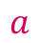
TD-Prediction
SARSA (On-Policy)
$$S$$
$$a$$
$$R$$
$$S′$$

Slide 29


TD-Prediction
SARSA (On-Policy)
$$S$$
$$a$$
$$R$$
$$S′$$
$$a=\left\{\begin{aligned}\begin{matrix}\underset{a∈𝒜(S^{′})}{argmax}{Q(S^{′}, a)} & 1−ε\end{matrix} \\ \begin{matrix}any & ε\end{matrix}\end{aligned}\right.$$

Slide 30

TD-Prediction
SARSA (On-Policy)
$$S$$
$$Q\left(S,A\right)⟻R+γ∙Q\left(S^{′},A^{′}\right)$$
$$R$$
$$S′$$

Slide 31
TD-Prediction
SARSA (On-Policy)
$$S$$
$$a$$
$$R$$
$$S′$$

Slide 32
TD-Prediction
SARSA (On-Policy)
$$S$$
$$a$$
$$R$$
$$S′$$
$$⋯$$
T

Slide 33




TD-Control
Q-Learning (Off-Policy)
$$Q\left(S_{t},A_{t}\right)←Q\left(S_{t},A_{t}\right)+α(R_{t+1}+γ∙Q\left(S_{t+1},A_{t+1}\right)−Q\left(S_{t},A_{t}\right))$$
SARSA
$$Q\left(S_{t+1},A_{t+1}\right)$$
$$Q\left(S_{t},A_{t}\right)←Q\left(S_{t},A_{t}\right)+α(R_{t+1}+γ∙\max_{a}{Q\left(S_{t+1},a\right)}−Q\left(S_{t},A_{t}\right))$$
$$\max_{a}{Q\left(S_{t+1},a\right)}$$
Q-Learning
One of the early breakthroughs in RL (enabled early convergence proofs)
Policy still has an effect in that it determines which state-action pairs are visited and updated
All that is required to convergence is that all pairs are continuously updated
$Q$ has been shown to converge with probability 1 to $q_{∗}$ under the usual stochastic approximation conditions (step sizes)

Slide 34



TD-Control
Q-Learning
$$S$$
$$a=\left\{\begin{aligned}\begin{matrix}\underset{a∈𝒜(S)}{argmax}{Q(S, a)} & 1−ε\end{matrix} \\ \begin{matrix}any & ε\end{matrix}\end{aligned}\right.$$

Slide 35


TD-Control
Q-Learning
$$S$$
$$R$$
$$S′$$

Slide 36



TD-Control
Q-Learning
$$S$$
$$Q\left(S,A\right)⟻R+γ∙\max_{a∈𝒜(S)}{Q\left(S^{′},a\right) }$$
$$R$$
$$S′$$

Slide 37
TD-Control
Q-Learning
$$S$$
$$R$$
$$S′$$

Slide 38

TD-Control
Q-Learning
$$S$$
$$R$$
$$S′$$
$$⋯$$
T

Slide 39

TD-Control
SARSA (On-Policy) vs Q-Learning (Off-Policy)
Undiscounted, episode task
Episode ends when agent gets to goal state
If agent falls over the cliff, it gets back to starting state and episode continuous

Slide 40



TD-Control
SARSA (On-Policy) vs Q-Learning (Off-Policy)
$$ε=0.1$$
Why is SARSA making more rewards, even though Q-Learning has the optimal solution?
Q-Learning agent occasionally falls down the cliff during exploration

Slide 41

TD-Control
SARSA (On-Policy) vs Q-Learning (Off-Policy)
$$ε=0.1$$
How can we make SARSA converge to the optimal policy?
Exploring rate needs to be gradually reduced, e.g. $ε=1/t$

Slide 42

TD-Control
Relationship Between DP and TD

Slide 43

TD-Control
Expected SARSA
Is that all?
Width of the update

Slide 44
TD-Control
Expected SARSA
Q-Learning moves deterministically to the maximum next state action pair
What if we move in the same direction as Q-Learning, except that we move in expectation?
Expected Sarsa can be implemented as an off-policy algorithm (which turns out to be exactly Q-Learning)
In fact, Expected Sarsa generalizes Q-Learning while reliably improving over Sarsa
$$Q\left(S_{t},A_{t}\right)←Q\left(S_{t},A_{t}\right)+α(R_{t+1}+γ∙\max_{a}{Q\left(S_{t+1},a\right)}−Q\left(S_{t},A_{t}\right))$$
$$Q\left(S_{t},A_{t}\right)←Q\left(S_{t},A_{t}\right)+α(R_{t+1}+γ∙\sum_{a}{π(a|S_{t+1})Q\left(S_{t+1},a\right)}−Q\left(S_{t},A_{t}\right))$$

Slide 45

TD-Control
Expected SARSA
Is that all?
Expected Sarsa
Width of the update

Slide 46

TD-Control
Expected Sarsa
(after first 100k episodes)
(after first 100 episodes)

Slide 47
Maximization Bias
Double Learning
All the control algorithms that we have discussed so far involve maximization in the construction of their target policies
Maximum over estimated values is used implicitly as an estimate of the maximum value, which can lead to a significant positive bias
Possibly best action
(exploitation)
Just take the best action

Slide 48


Maximization Bias
Double Learning
Always a mistake!
$$v^{∗}\left(B\right)=−0.1$$
But our control algorithms may favor left because of maximization bias making B appear to have a positive value

Slide 49


Maximization Bias
Double Learning
Taking left option much more often than the 5% minimum probability enforced by e-greedy action selection with
$$ε=0.1$$

Slide 50
Maximization Bias
Double Learning
Samples (Plays)
Determine Maximization Action
Determine
Its value
What if separate samples into two sets, and use them to learn two independent estimates?

Slide 51






Maximization Bias
Double Learning
$$A^{∗}=arg\max_{a}{Q_{1}(a)}$$
$$Q_{2}(A^{∗})=Q_{2}(arg\max_{a}{Q_{1}\left(a\right)})$$
$Q_{1}$ Learns the best action
$Q_{2}$ provides the (unbiased) estimate of its value ${𝔼[Q}_{2}(A^{∗})]=q(A^{∗})$
$$A^{∗}=arg\max_{a}{Q_{2}(a)}$$
$$Q_{1}(A^{∗})=Q_{1}(arg\max_{a}{Q_{2}\left(a\right)})$$
Although we learn two estimates, only one estimate is updated on each play; double learning doubles memory requirements, but does not increase computation cost

Slide 52

Maximization Bias
It could be Double Expected Sarsa…
Double Learning
Behavior Policy can use both action-value functions (average or sum)

Slide 53

Maximization Bias
Double Learning

Slide 54
Thank you!
Questions?

